Slide 1





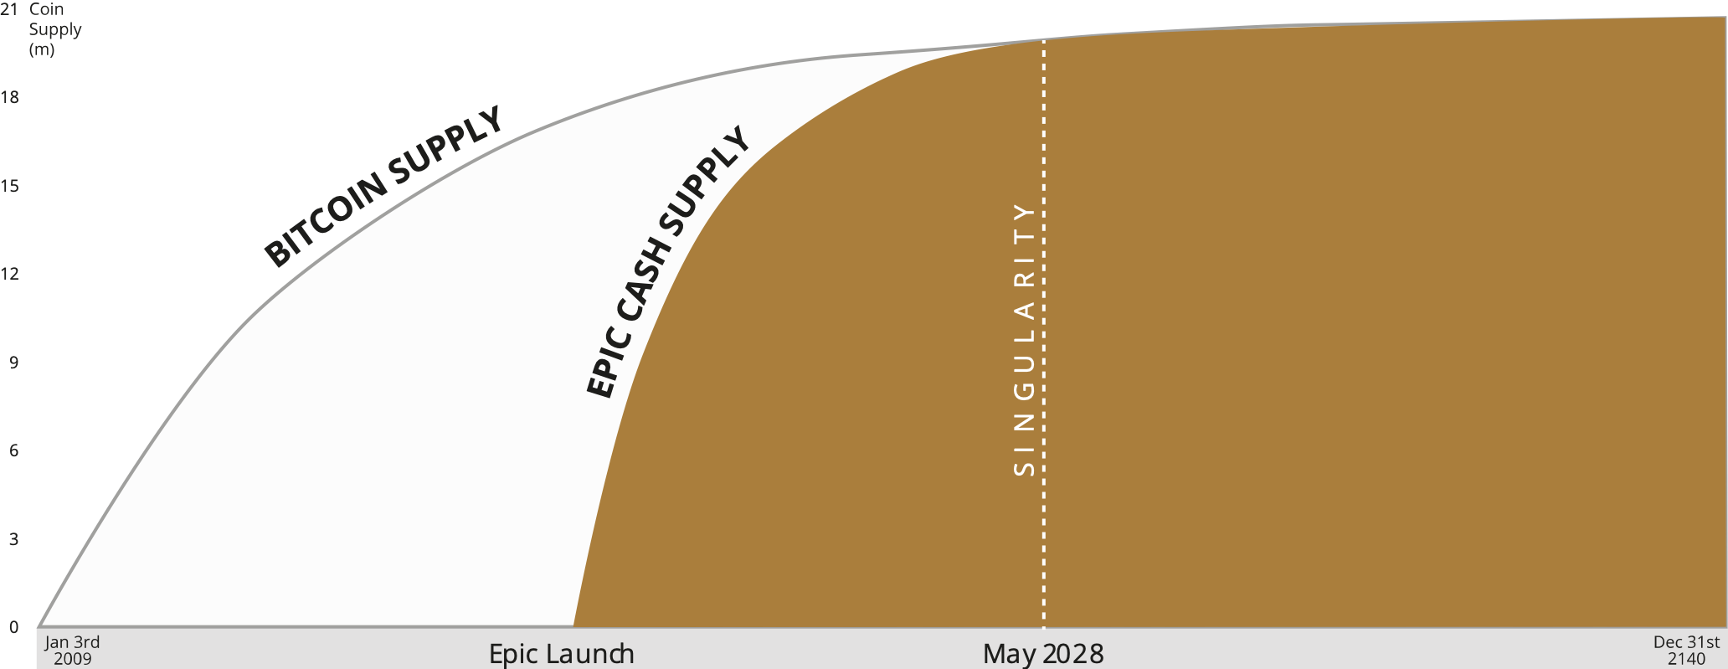








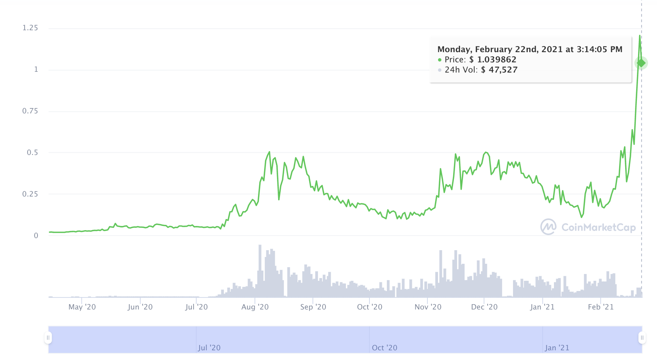





FAIR LAUNCHED
100% PoW Mined
NO ICO
NO PREMINE
NO VC’s
NO COMPANY
EPIC is an all-volunteer community project that launched in September 2019
21M MAXIMUM SUPPLY DEC 2140
100% PRIVATE TRANSACTIONS
based on Mimblewimble
ADDRESS INVISIBLE
AMOUNT INVISIBLE
BITCOIN STANDARD MONETARY POLICY
ANYONE CAN MINE
60% General-purpose CPU, AMD/Intel
* True smartphone mining coming in 2021
38% Standard GPU, AMD/NVIDIA
2% Specialized ASIC
FIND OUT MORE
TRADED ON:
COMMUNITY:
Uniswap
t.me/EpicCash
Vitex
@EpicCashTech
Citex
Epic Cash
Epic on a page v03 Feb 2021

